Slide 1
Predicting Stock Market Trends through
Monte Carlo Simulation
Using Python and GBM Model
Presented by
Arian Wazed

Slide 2
Abstract
The study employs Python to analyze stock market volatility using the Geometric Brownian Motion mathematical model, simulating Samsung's stock prices over a thousand cycles for retail traders.

Slide 3
Introduction :
Monte Carlo Simulation is a finance tool that predicts stock prices based on factors like company performance, market trends, and economic changes. It generates thousands of predictions, enabling investors to make informed decisions. The EMH suggests the market discounts details, but hedge funds like Berkshire Hathaway can outperform. The GBM model uses Monte Carlo Simulation for future stock price predictions.

Slide 4
Problem Statement
This study aims to improve consumer traders' performance by incorporating Monte Carlo simulation and data analysis from other studies. The study aims to improve the public's perception of the stock market by incorporating Monte Carlo analysis and integrating it with the GBM model, thereby advancing financial analysis and enhancing shareholder results.

Slide 5
Research Objectives
1.Collect and evaluate data from financial websites
2.Analyze market volatility in Malaysia and the United States
3.Simulate stock prices using GBM model over a thousand cycles

Slide 6
RESEARCH AIMS, OBJECTIVE & RESEARCH QUESTIONS
The paper uses Python's Monte Carlo technique to predict stock values using the Geometric Brownian Motion (GBM) model. Data from stooq.com was used to simulate future market stock movements. The research aimed to forecast Samsung's stock price through 1000 simulations, evaluating model robustness, sensitivity to parameter changes, and discrepancies.

Slide 7
Significance of this research
A JP Morgan survey shows that 53% of traders consider projected and real-time market conditions as the most important data tool. However, institutional hedge funds lack sophisticated instruments, increasing their vulnerability to stock market losses. A study uses Monte Carlo Simulation to provide accurate forecasts for retail traders, filling a gap in sophisticated tools and emphasizing the importance of accurate prediction in risk mitigation and trading results.

Slide 8
Literature Review
This paper explores the application of the Monte Carlo method in predicting stock returns, focusing on the COVID-19 pandemic's severe disruption and the subsequent rebound in the technology and healthcare industries. The study highlights the quickest and biggest crash in stock market history, with 11 bear markets since 1956.

Slide 9
Literature Review Contd.
Bear markets often follow bull markets, with resilient companies becoming more powerful. Recovery periods can be lengthy, like the 2008 crisis. Monte Carlo Simulations are useful for forecasting stock market movements, especially when share prices show random behavior.

Slide 10
Implementation Results and Outcomes
A Monte Carlo Analysis was conducted using Python and simulations to simulate future market index movement. The GBM model's parameters were based on market statistics from stooq.com. The Monte Carlo approach is widely used to include uncertainties in evaluating stock price movement. To model Samsung's stock price, 1000 simulations were run using data from the previous 5 years. Analysts should select a timeframe that closely resembles the forecast period.

Slide 11
What is GBM?
Geometric Brownian Motion (GBM) is a stochastic process used to predict market prices, including Malaysian gold prices. Johannes Voit's model, which considers past returns and the drift component, improves prediction accuracy by considering macroeconomic variables, global trends, and geopolitical events.

Slide 12
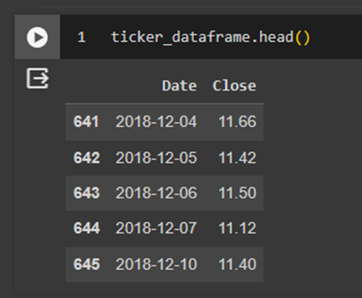
Data Cleaning
That’s what our refined Data is going to look like

Slide 13
Implementation contd.
The focus is on creating a simulation model using the Monte Carlo Method and the Geometric Brownian Motion (GBM) method. The Monte Carlo function is simple, iterating over a specified function and recording each iteration. The GBM method is more complex, employing equations from a 2016 research article by Reddy and colleagues.

Slide 14
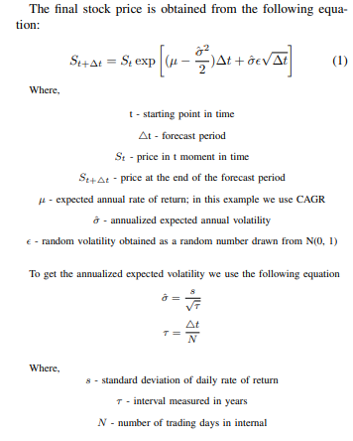
Implementation contd.
After we implemented the following equations into the python code, there is one thing left to do, and that is to run the simulation and observe the results. After running 1000 simulations, we get the results.

Slide 15
Methodology
The study analyzed the performance of Samsung's stock prices using data from trustworthy sources, including Stooq. The data was structured and saved into an Excel file for further modification. Data cleaning was done to ensure authenticity. Python was used for a thorough study of stock market movements, and the GOOGLE COLABORATORY was used to display the results of Monte Carlo simulations. This approach provided a comprehensive perspective on future stock price estimates and helped understand possible market moves.

Slide 16
Discussion
Monte Carlo Simulation is a statistical modeling tool used for stock price prediction, allowing investors to consider various future trajectories of a stock's value. It reveals significant risk factors and unusual scenarios. The discussion phase assesses the model's robustness, identifying differences between simulated and actual market behavior, and addressing shortcomings. This helps investors make informed decisions in the uncertain financial market.

Slide 17
Limitations
Data Quality and Sources: The accuracy of the forecasts is strongly dependent on the data quality.
GBM Model Assumptions: The Geometric Brownian Motion (GBM) model considers constant parameters like Shock and drift, which may not be the case in all market situations. Alterations from these presumptions might cause errors in forecasts.
Market Dynamics: Economic events, geopolitical happenings, and regulatory changes all have an impact on financial markets. The GBM model may not fully reflect the intricacies of these dynamic factors, perhaps leading to disparities between expected and actual shifts in markets.
Overfitting danger: There is a danger of overfitting the model to historical data when tweaking parameters or running plenty of Monte Carlo Simulations. As a result, the model can operate well on historical data but terribly on fresh, unknown data.

Slide 18
Our Future Work
Explore alternative prediction models beyond GBM for stock value projections, considering machine learning algorithms and hybrid models for comparative analysis.
Enhance prediction accuracy by incorporating additional variables like macroeconomic indicators, sector-specific data, and social media insights to better understand stock market dynamics.
Design models with dynamic parameters to adapt to changing market conditions using machine learning techniques for continuous parameter updates.
Integrate risk management measures into forecasting to assess and mitigate uncertainty, improving the practical application of research for investors.
Develop real-time data analysis methodologies for timely and informed decision-making, creating models that continually evaluate incoming data for up-to-the-minute forecasts.
Conduct thorough back-testing and verification with out-of-sample data to assess the model's resilience and generalizability, providing a comprehensive evaluation of predictive ability.

Slide 19
Conclusion
The study used Monte Carlo Analysis to predict stock market trends using the Geometric Brownian Motion (GBM) model. The model was run using Python and multiple simulations, allowing for accurate predictions. The study demonstrated the model's applicability in predicting market movements, helping traders make informed decisions. However, caution was advised due to underlying assumptions. The study suggests further research to demonstrate its application in larger corporate scenarios.

Slide 20
Thank You

